Slide 1
BCUS101 – Bayesian Calibration Tutorial
A Integrated Workflow to Perform BCUS
Bayesian Calibration, Uncertainty Analysis and Sensitivity Analysis
on OpenStudio Models
September 2019

Slide 2
Read me
Limited number of output variables:
Electricity:Facility
Electricity:Building
Gas:Facility
Heating:Gas
Heating:Electricity
Cooling: Electricity
Electricity:HVAC
Limited subset of uncertain parameters
Check the “Parameter_UQ_Repository_V1.0.xlsx” for list of uncertain variables
Thermostat setpoint temperature cannot be calibrated due to the variation of setpoint within a daily schedule profile
Bayesian Calibration only calibrate one year of simulation with monthly utility data

Slide 3
Overview
This tutorial will lead you through the procedures of applying BCUS - Bayesian Calibration, Uncertainty Analysis and Sensitivity Analysis on OpenStudio models.
Before you start, a functioning OpenStudio model and an EPW weather file are desired to illustrate the building and its surrounding environment being analyzed. Details of how to build an OpenStudio building model can be found here. Weather files can be downloaded here.

Slide 4
Get Started
PREREQUISITE
INSTALLATIONS
Executing BCUS typically requires the following tools and packages:
OpenStudio
EnergyPlus
Microsoft Office(Some functions will be eliminated if using Libre Office in Ubuntu, i.e. drop down list)
R
R packages
SET ENVIRONMENT
Once the prerequisite tools are installed, set up the platform variables to access executables, examples and tests.
TEST INSTALLATION
To make sure BCUS runs correctly:
Test the Ruby-OpenStudio environment
Test installation by running a simple example
SIMPLE
EXAMPLES
Step by step following the tutorial which demonstrate the basic procedure of running BCUS.
Notes:
- To use Ruby from OpenStudio Installation Package: Add path environmental variable: e.g., C:\Program Files\openstudio-2.7.0\ruby-install\ruby\bin
Install Ruby gems: run cmd.exe as administrator, then install required gems like e.g. “gem install rinruby”

Slide 5
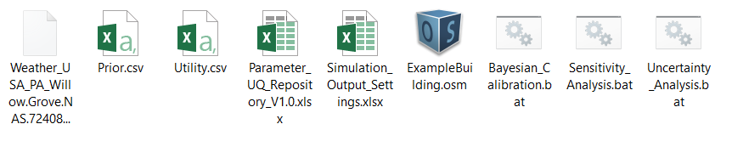
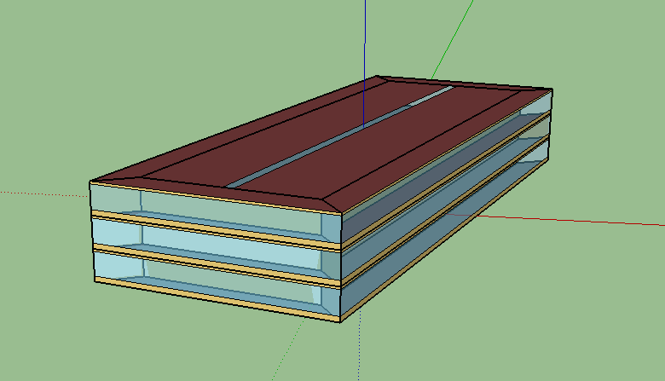
Example File
Building Description
In the Example folder, users can find the ExampleBuilding.osm model with required input files in order to run BCUS.
The example building is a 3-story, 100,000 sqft office building located in PA. It has a rectangular footprint and 50% window-to-wall ratio. The heating, ventilation and air conditioning system in the building is VAV system with DX cooling (COP =2.6). The electric resistance serves the central heating and reheat in the VAV system.

Slide 6
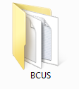
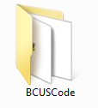
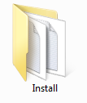
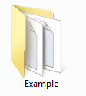
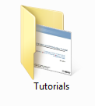
Examples
Create a Project Folder
The BCUS Package is distributed in the format of a zip folder named “BCUS.zip", the first step is to extract the folder to a local directory on your computer. The main folder contains 4 subfolders as shown below.
BCUSCode: Ruby codes to run the program
Install: Help first time users install the required packages, setup
the path and check the status of the installation
Example: The example building model and required inputs
Tutorials: Tutorial document

Slide 7
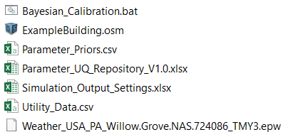
Examples: Input Files Format
Input Files
Create a project folder inside the main folder
Copy the files in: …\BCUS\Example and paste them to the project folder. Now you would see the following files in your project folder.
After pasting the seven required input files for Bayesian calibration, replace the ExampleBuilding.osm with your building model; replace the .epw file with the weather file for your building’s location, replace the Prior.csv and Utility.csv with your building’s information if applicable.

Slide 8
Step 1: Create Prior Uncertainty File
Open …Example/SA_Output/UQ_Building_name.csv
Change the distribution to Triangle/Normal Absolute.
Assign prior distribution parameters for each selected sensitivity parameter.
Make sure the required prior distribution information is correct
Save the file as Parameter_Priors.csv in your project folder (do not change the name), here we save it to: …/BCUS/Example
Parameter Type | Object in the model | Parameter Base Value | Distribution | Mean or Mode | Std Dev | Min | Max
Infiltration | FlowPerExteriorArea |  | Triangle Absolute | 0.00095 |  | 0.000319 | 0.002894
Lights_WattsPerSpaceFloorArea | Office_Space_Type | 15.17433543 | Normal Relative | 1 | 0.5 | 0 | 50
PlugLoad_WattsPerSpaceFloorArea | Office_Space_Type | 8.072932813 | Normal Relative | 1 | 0.5 | 0 | 50
People_SpaceFloorAreaPerPerson | Office_Space_Type | 18.58060872 | Normal Relative | 1 | 0.5 | 0 | 30
DesignSpecificOutdoorAirFlowPerZoneFloorArea | Office_Outdoor_Air | 0.0004318 | Normal Relative | 1 | 0.01 | 0 | NA
Change the distribution accordingly
Assign prior distribution parameters (including appropriate value bounds)

Slide 9
Step 1: Create Prior Uncertainty File (Cont.)
In case that the sensitivity analysis is not a prerequisite, the user need to make sure the input format in Prior.csv obey the form in the image below.
Assign prior distribution parameters for each selected sensitivity parameter.
Make sure the required prior distribution information is correct
Save the file as Parameter_Priors.csv in your project folder (do not change the name), here we save it to: …/BCUS/Example
Parameter Type | Object in the model | Parameter Base Value | Distribution | Mean or Mode | Std Dev | Min | Max
Infiltration | FlowPerExteriorArea |  | Triangle Absolute | 0.00095 |  | 0.000319 | 0.002894
Lights_WattsPerSpaceFloorArea | Office_Space_Type | 15.17433543 | Normal Absolute | 15.17434 | 7.58716 | 0 | 50
PlugLoad_WattsPerSpaceFloorArea | Office_Space_Type | 8.072932813 | Normal Absolute | 8.072933 | 4.03646 | 0 | 50
People_SpaceFloorAreaPerPerson | Office_Space_Type | 18.58060872 | Normal Absolute | 18.58061 | 9.29030 | 0 | 30
DesignSpecificOutdoorAirFlowPerZoneFloorArea | Office_Outdoor_Air | 0.0004318 | Normal Absolute | 0.000432 | 4.32E-06 | 0.0004 | 0.0005
Change the distribution accordingly
Assign prior distribution parameters (including appropriate value bounds)

Slide 10
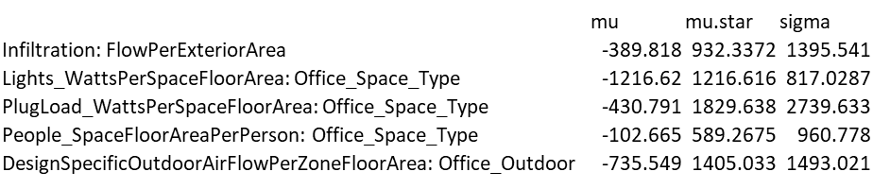
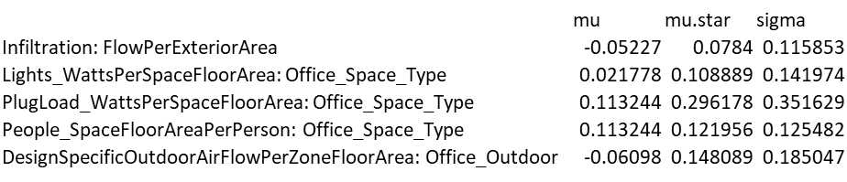
Step 2 Calibration Parameters Selection (Not a mandatory step)
We first run a sensitivity analysis to select top ranking parameters which have significant impact to the simulation output. In this example, we will take the results directly from previous sensitivity analysis.
Navigate to …/Example/SA_Output folder and open:
SA_wrt_Electricity.Total.End.Uses..GJ..csv
SA_wrt_Natural.Gas.Total.End.Uses..GJ.csv
Select parameters with high rankings according to mu.star.
In this example, we select the lights, plug load, and outdoor air flow rate respectively.
SA on Total Electricity Use
SA on Total Gas Use
Notes:
If you not sure which parameter you want to calibrate, skip to slides blahblah

Slide 11
Step 3: Create Utility/Measurement file (Monthly)
Create the Utility_Data.csv file in your project folder and save the monthly measurement of electricity and gas in the .csv file.
Note: The unit of the measurement data is required to be converted to [J].
 | Electricity Consumption [ J ] | Natural Gas [ J ]
January | 6.67E+11 | 9990447380
February | 7.43E+11 | 9218470444
March | 5.90E+11 | 10259898888
April | 4.99E+11 | 8904568226
May | 5.67E+11 | 9202115902
June | 5.33E+11 | 8238895970
July | 6.20E+11 | 7680854044
August | 5.80E+11 | 7993387438
September | 4.63E+11 | 7689287082
October | 5.73E+11 | 8401852539
November | 5.51E+11 | 8936406624
December | 6.04E+11 | 9341400532

Slide 12
Step 3: Edit Executable Bash/Batch Script
Open Bayesian_Calibration.bat file using any available text editing software:
Replace current file names with your building model name and weather file name.
You can save the modified bash script with a new name, such as Run_Calibration.bat or just keep the old name.
List of inputs. Add --help for detail explanations
Will use default values if left blank in the input
Replace with the name of your
building model
Replace with the weather file of your building model

Slide 13
About the Bash Script
--osm: The name of the OpenStudio model (.osm)
--epw: The name of the weather file(.epw)
--priorsFile: Prior uncertainty distribution table (.csv)
--utilityData: Utility data (.csv)
--outFile: The name of the simulation output setting file (.csv)
--simFile: Filename of computer simulation outputs (.txt)
--fieldFile:Filename of utility data measured from the field meter for comparison (.txt)
--postsFile: The filename of posterior distributions (.csv)
--pvalsFile: The filename of pvals (.csv)
--numLHD: The number of sample points of Monte Carlo simulation with Latin Hypercube Design
--numMCMC: The number of MCMC steps. The number should be large enough to derive a good approximation of posterior distribution.
--numBurnin: The number of burning samples to dump in initial steps of MCMC. Suggested value: 10% NumMCMC

Slide 14
About the Bash Script – Cont.
--numOutputVars: The number of output variables used for calibration. 1 for either electricity or natural gas; 2 for both electricity and natural gas
--numWVars: The number of weather variables
--seed: Need to be an integer. If same, the sequence of the samples will be the same
--numProcesses: The number of parallel processes for running EnergyPlus simulations
--noSim: If true, no OpenStudio models will be generated
--noEP: If true, no EnergyPlus simulation will be performed
--noCleanup: If true, intermediate files will be kept
--noPlots: If true, plots of posterior distributions will not be generated
--noRunCal: If true, no calibrated model will be generated and simulated
--interactive: If true, there will be dialogue between the user and the program
--verbose: If true, run in verbose mode with more output info printed
--help: Display help

Slide 15
Step 3: Run Executable Bash Script in the Terminal
Launch the Terminal in your operating system:
For OSX – Press Command + Space and type terminal and press Enter
For Linux – Open the Dash by clicking the Ubuntu icon in the upper-left, type terminal, and
select the Terminal application from the results that appear.
or simply hit the keyboard shortcut Ctrl-Alt+T.
For Windows – Click Start, in the search box type cmd and press Enter
Navigate to your project folder
Click the cursor in your Terminal/cmd type:
cd <your project folder directory>
For example,
cd /Users/username/Documents/OpenStudio/BCUS/Example
Run the bash script you just modified by type:
Bayesian_Calibration.bat (Windows)
sh Run_BC.sh (Linux/OSX)

Slide 16
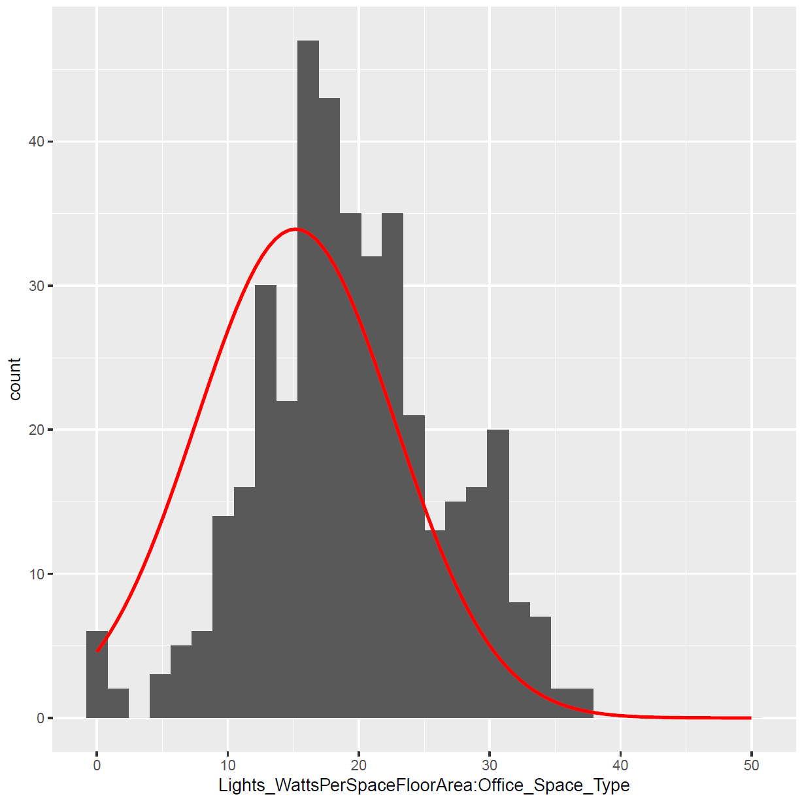
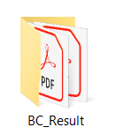
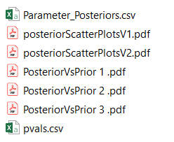
Output Files
Output Files
The Output files for Bayesian Calibration are generated in the .../BC_Result folder.
Plots of prior and posterior distributions of calibration parameters
Example plots of posterior

Slide 17
Interpretation of the results
The peak of the distribution shifts to the right
The full range does not reduce notably
The most likely region does not reduce notably, either

Slide 18
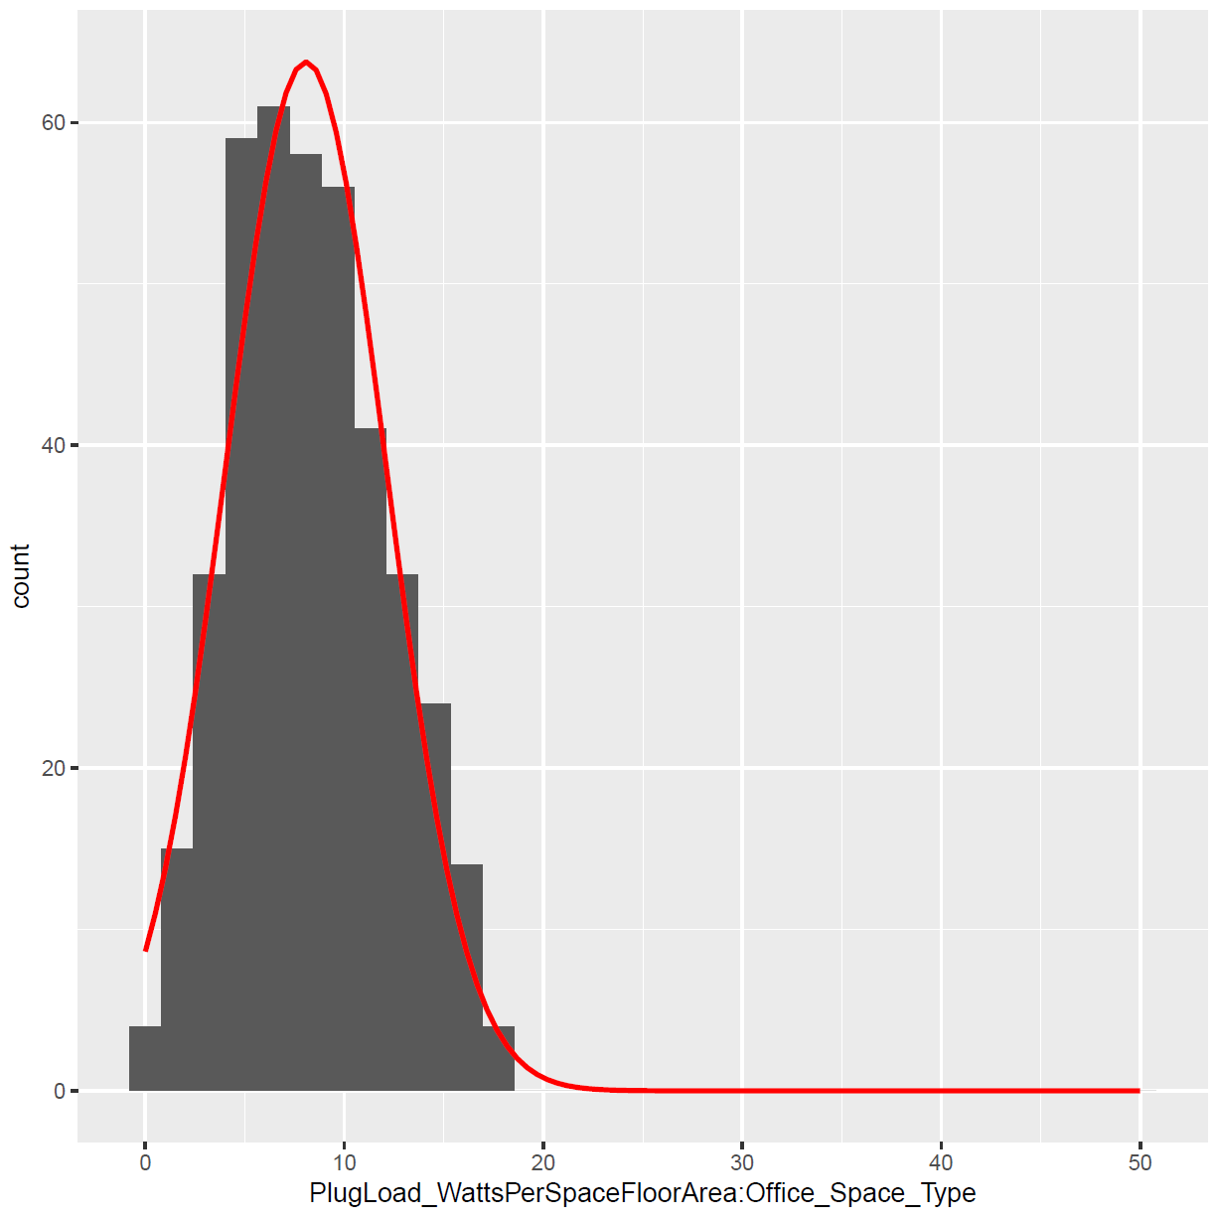
Interpretation of the results
Uncertainty didn’t reduce much, The peak didn’t shift

